Slide 1
LSTM vs ARIMA vs XGBoost for Credit Risk Forecasting Alex Vajiac, Diego Nino

Slide 2
Agenda
Background
Data
Methodology
Models Used
Results
Conclusion
Future Plans

Slide 3
Background
Credit risk, in the context of insurance firms, is the potential loss from a counterparty failing to meet financial obligations, impacting an insurer's ability to pay policyholders.
The Altman Z-score is a common metric used to assess credit risk using financial ratios and is calculated as follows:

Slide 4
Data
For the data, we pulled the financial numbers for 17 insurance companies: Berkshire Hathaway, Marsh & McLennan, Progressive, Allstate, Arthur J. Gallagher, MetLife, Prudential, Travelers, American International, Fidelity, Markel, First American, Hartford Financial Services, Brown & Brown, Assurant, Aflac and Unum
The data is in time-series format from Q4 2014 to Q1 2024 and includes Total Assets, Retained Earnings, EBIT, Shareholders’ Equity, Total Liabilities and Working Capital (i.e the ratios that are being forecasted)

Slide 5
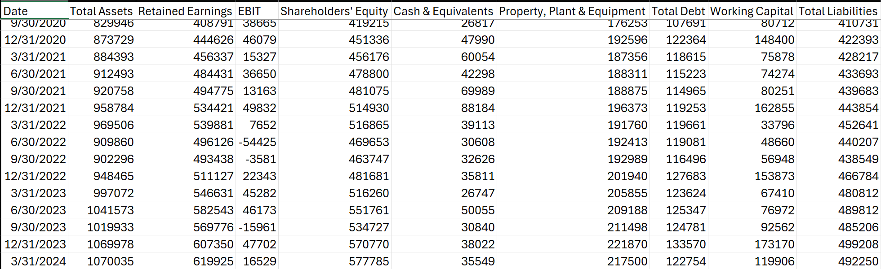
Data

Slide 6
Methodology
For each of the 17 companies, using ARIMA, LSTM and Xgboost, we forecasted one step ahead (i.e. for Q2 2024) for Total Assets, Retained Earnings, EBIT, Shareholders’ Equity, Total Liabilities and Working Capital
Then, we used the Altman Z-score formula to determine based on the forecasted numbers using the following ratios:
Working Capital/Total Assets, Retained Earnings/Total Assets, EBIT/Total Assets, Equity/Total Liabilities
Afterwards, we used the threshold of Altman Z-score > 1.95 to determine if a company was at low or high credit risk (0 for low credit risk and 1 for high credit risk)
In the end, we compared the results with the actual results in Q2 2024 regarding credit risk

Slide 7
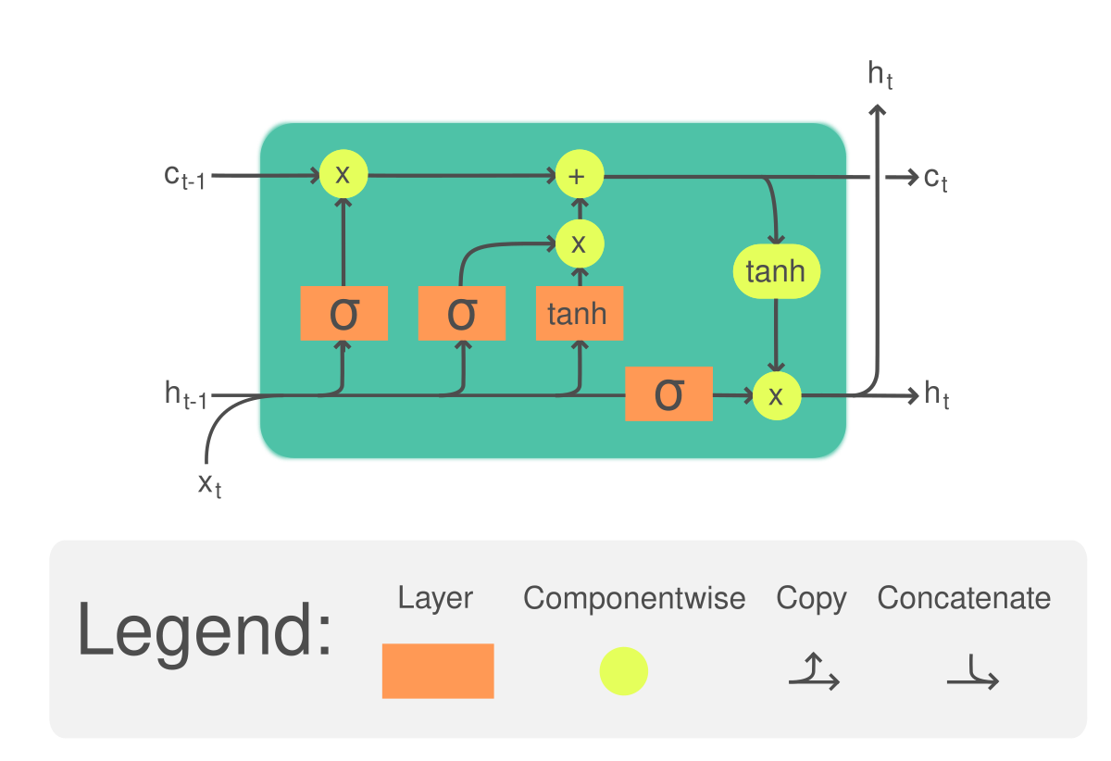
Models Used
LSTM
A type of recurrent neural network (RNN) designed to learn from sequential data with long-term dependencies
Uses memory cells and gating mechanisms to retain information over long sequences
Ideal for non-linear and complex time dependencies in sequential data.
ARIMA
A classical statistical model used for analyzing and forecasting univariate time series
Combines three components: autoregression (AR), differencing (I), and moving average (MA)
Best suited for linear time series data that shows trends but not strong seasonality
Xgboost
A powerful, scalable machine learning algorithm based on gradient-boosted decision trees
Unlike ARIMA or LSTM, it doesn't assume temporal order—so time features like lags, rolling statistics, and time stamps must be manually added
Excels at capturing non-linear patterns and interactions in historical data

Slide 8
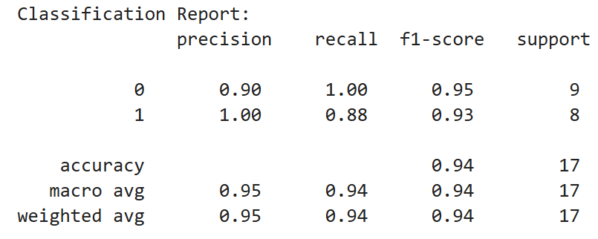
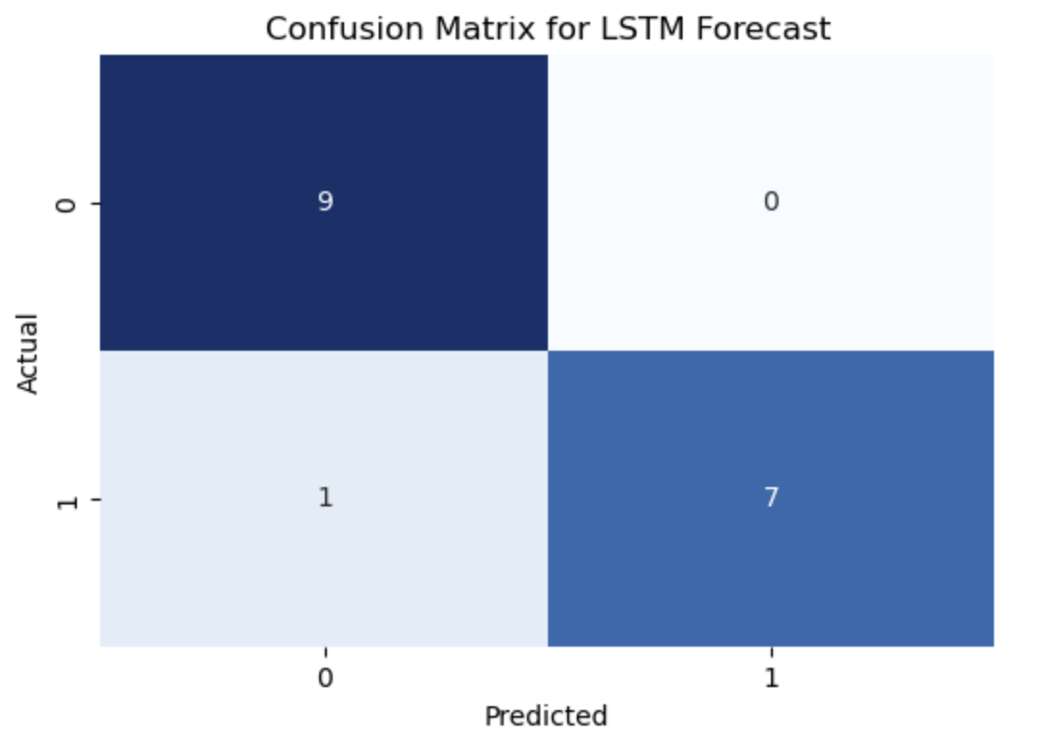
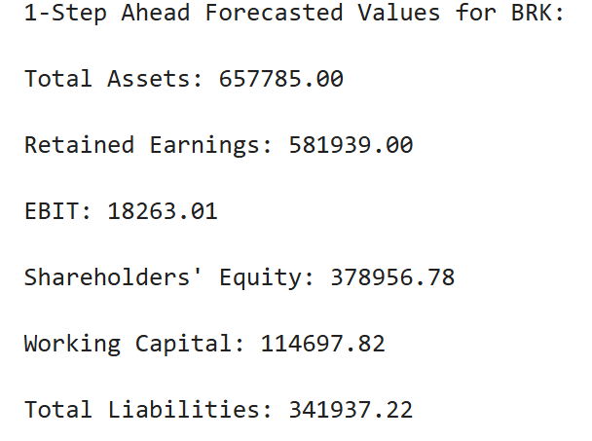
Results - LSTM

Slide 9
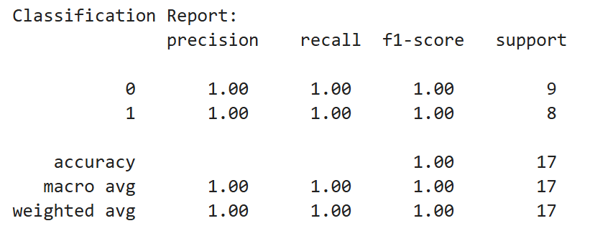
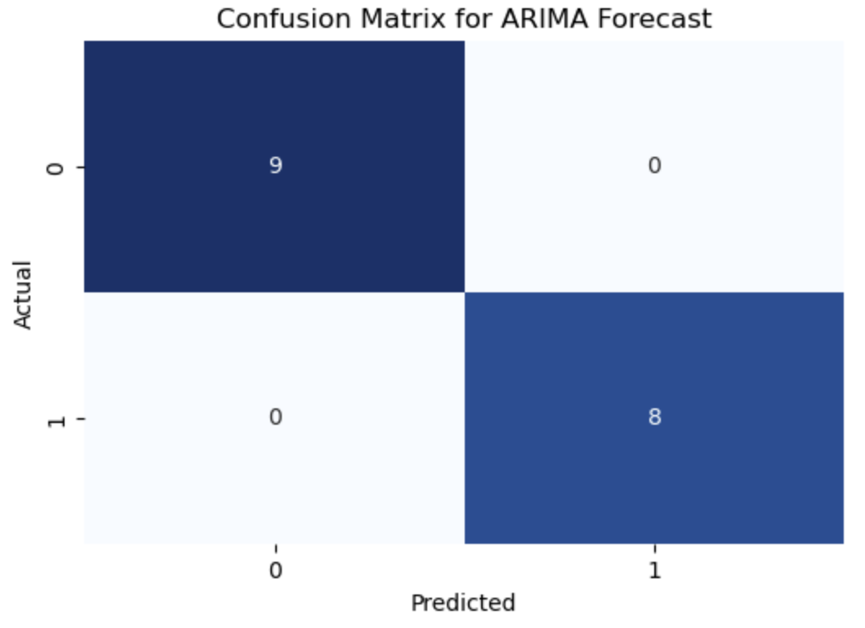
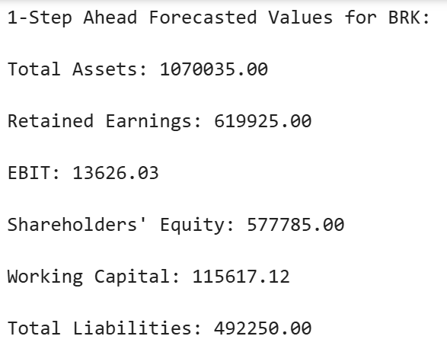
Results - ARIMA

Slide 10
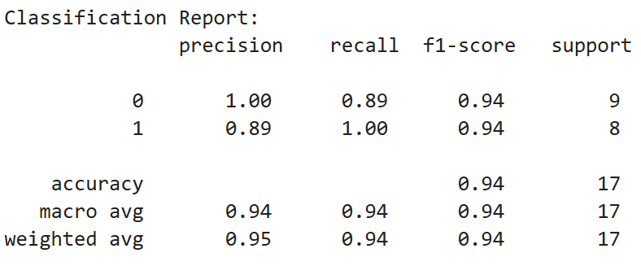
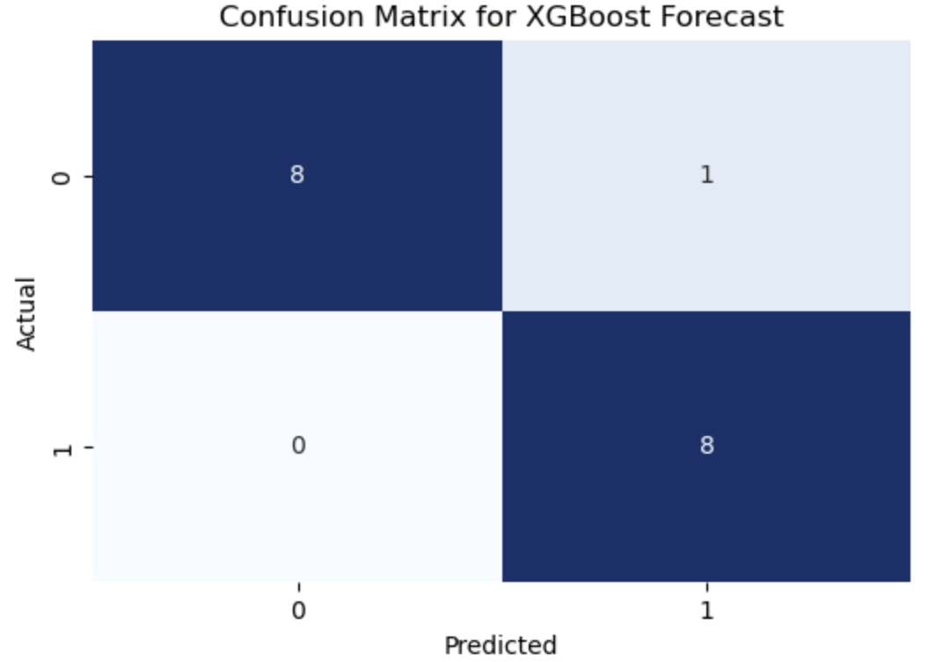
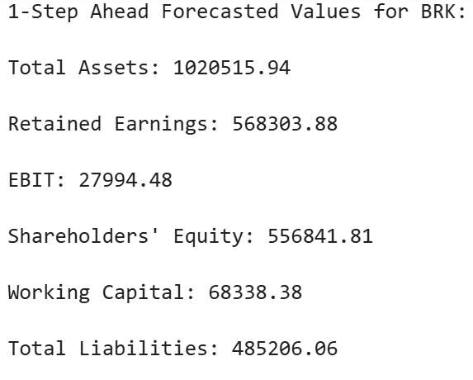
Results - XGboost

Slide 11
Results Explained
While the models were all accurate in predicting credit risk, with ARIMA having 100% accuracy and the other 2 having 94%
However, the models had widely different predictions regarding the actual numbers due to differences in how the models capture time-series trends, ARIMA being the most accurate with Xgboost being the close second.
Scaling on the LSTM side might be one of the reasons why, with ARIMA being able to capture linear variables like Total Assets well whereas XGBoost works well for nonlinear variables such as EBIT (earnings before income and tax)

Slide 12
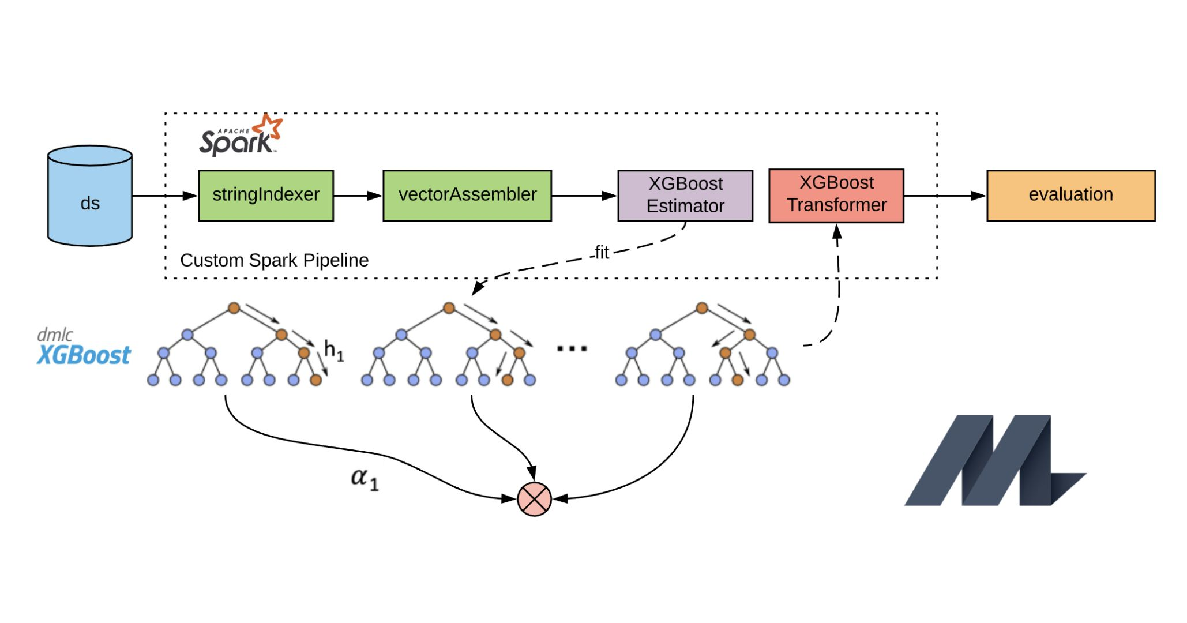
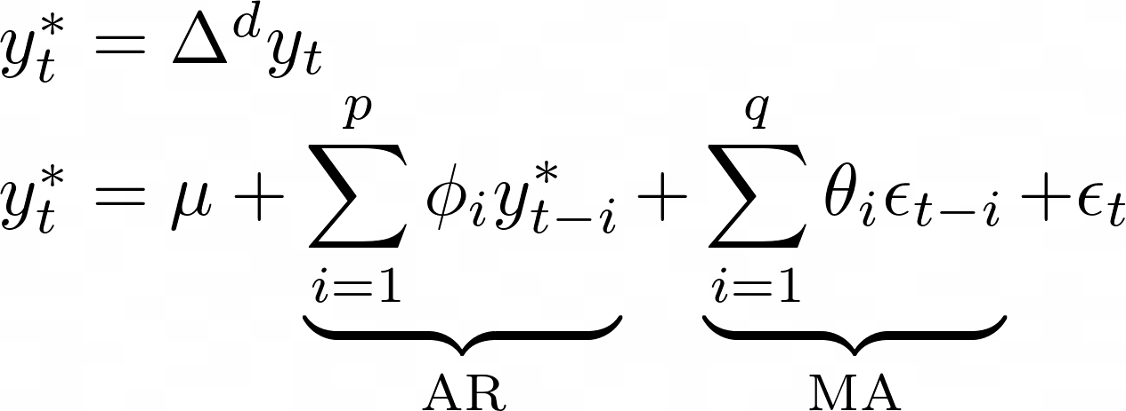
Conclusion
Sometimes, simple works best
ARIMA being a linear time series prediction model and Xgboost being a tree-based ML classifer performed significantly better than LSTM in this scenario due to fewer moving parts and no reliance on scaling

Slide 13
Future Plans
Compare the models’ performances on a larger set of insurance companies to have more data points
Add economic indicators to further increase the accuracy of the model to predict financial numbers
Build the model to take more indicators of financial data into account and further improve on LSTM architecture to accurately forecast EBITDA as a function of multiple line items (can be generalized to any company in any industry)

Slide 14
Thank you
Alex Vajiac and Diego Nino
714-381-5515
alexvajiac500@gmail.com
https://www.linkedin.com/in/alex-vajiac-642039105/

